Slide 1
Hardware/Software Co-Exploration of Neural Architectures on FPGAs
Weiwen Jiang
Postdoc Scholar
wjiang2@nd.edu
https://wjiang.nd.edu

Slide 2
Outline
Introduction
XFER: Achieving Super-Linear Speedup across Multi-FPGA
- CODES+ISSS’19 (Best Paper Finalist)
Co-Exploration of Neural Architecture and FPGA Implementation
- DAC’19 (Best Paper Finalist)
Other Research Directions
Conclusion
1
Notes:
Page 1:
My talk will be composed of four parts.
First, I will brefiely introduce the background of these works.
Then, I’ll present two recent works. The first one is transfer, which is a design to achieve super-linear performance of convolutional neural networks across Multiple FPGAs. This work is just accepted by CODES+ISSS.
The second one is FNAS, which is a framework to support co-exploration of Neural Architectures and FPGA implementations.
Finally, I’ll conclude this talk.

Slide 3
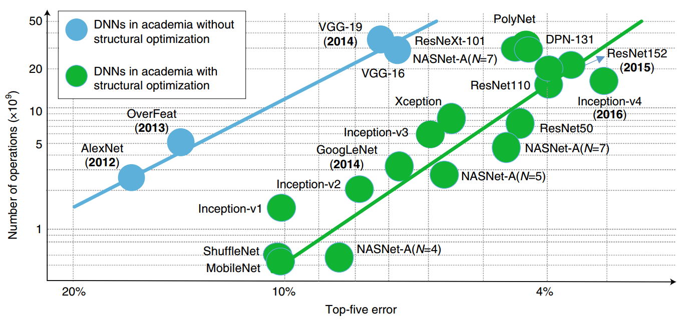
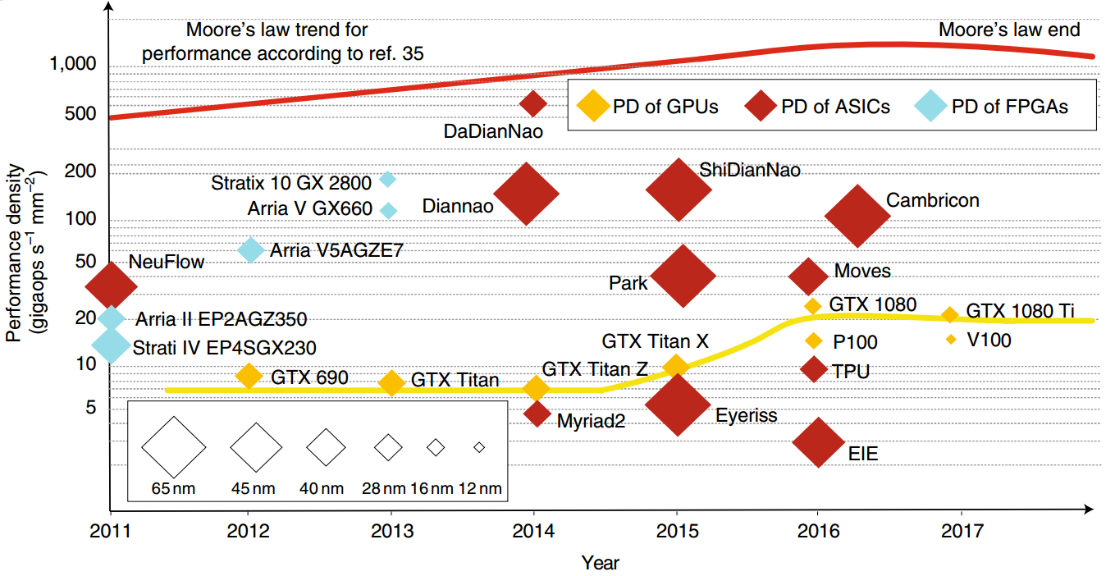
Computation Demand > Supply
2
Number of DNN operations increases exponentially
Performance density almost stops increasing
[ref.1] Xu, Xiaowei, et al. "Scaling for edge inference of deep neural networks." Nature Electronics 1.4 (2018): 216.
[ref.2] Sutter, H. The free lunch is over: A fundamental turn toward concurrency in software. Dr Dobb’s J. 30, 202–210.

Slide 4
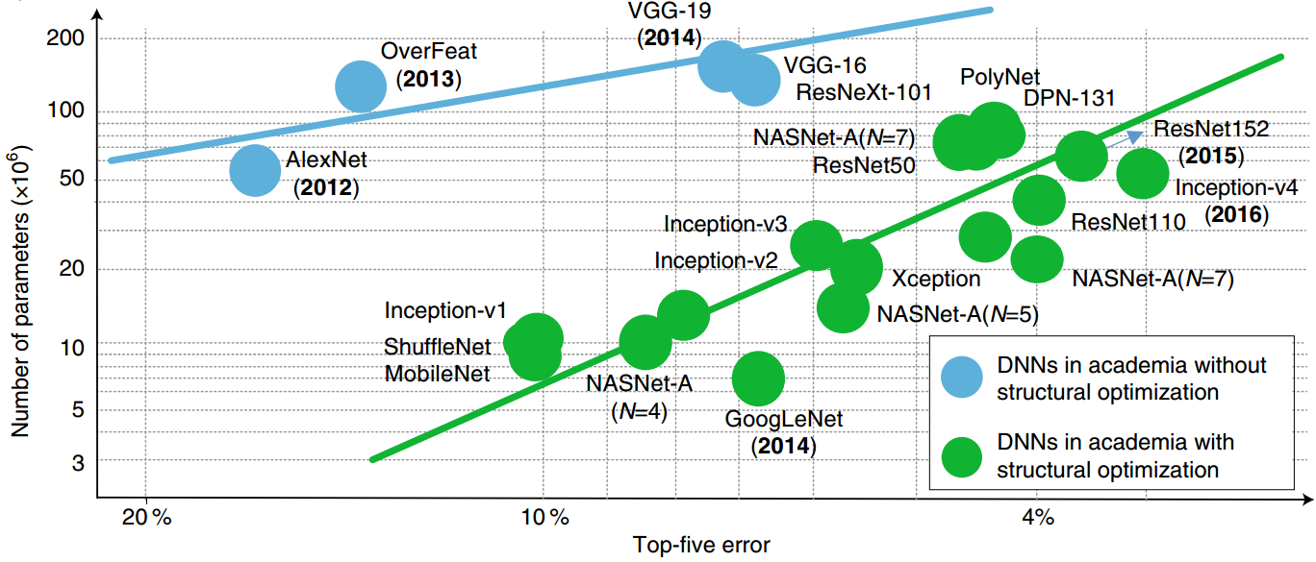
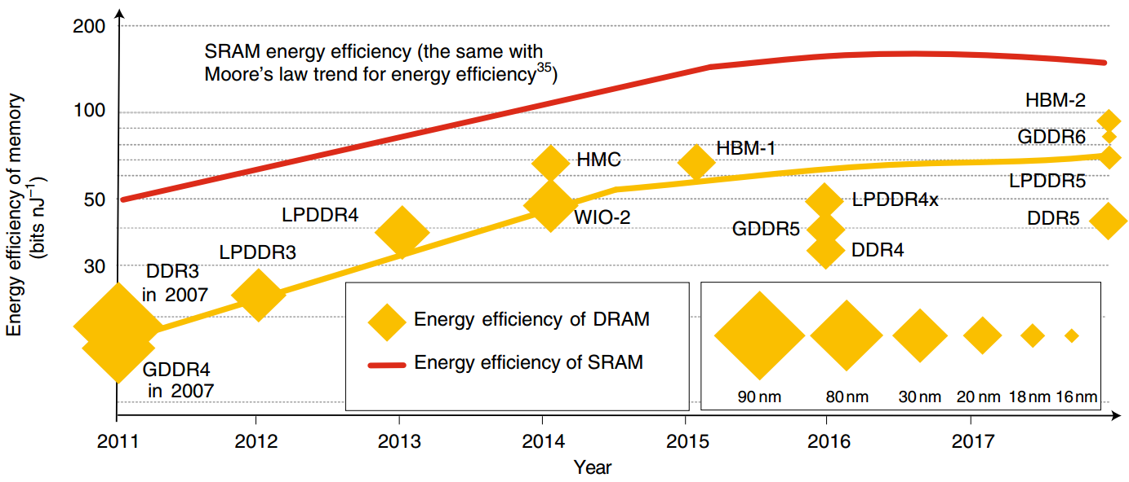
Storage Demand > Supply
Number of DNN parameters increases exponentially
Energy efficiency of memory almost stops increasing
[ref.1] Xu, Xiaowei, et al. "Scaling for edge inference of deep neural networks." Nature Electronics 1.4 (2018): 216.
[ref.2] Sutter, H. The free lunch is over: A fundamental turn toward concurrency in software. Dr Dobb’s J. 30, 202–210.

Slide 5
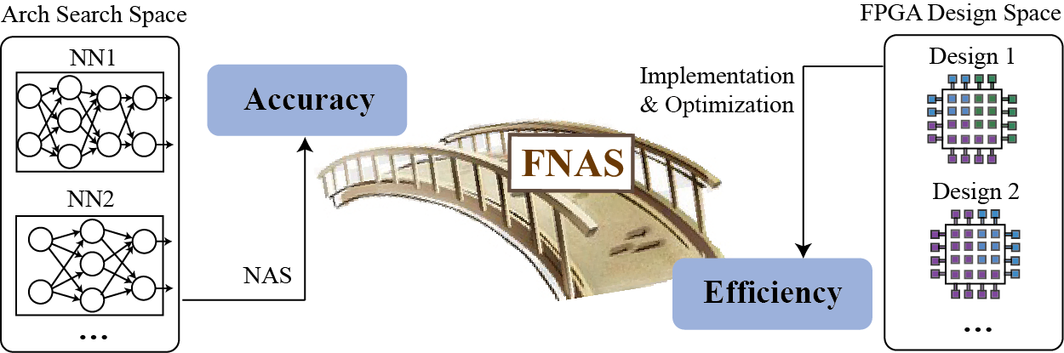
Efforts on Both Software and Hardware Sides are Required
Neural Architecture Search
Neural Architecture Implementation on FPGAs
4
4
Notes:
Page 6:
Now, let’s move our eyesight to the other side of the bridge. I will introduce the progress of neural architecture search in the following.

Slide 6
Outline
Introduction
XFER: Achieving Super-Linear Speedup across Multi-FPGA
- CODES+ISSS’19 (Best Paper Finalist)
Co-Exploration of Neural Architecture and FPGA Implementation
- DAC’19 (Best Paper Finalist)
Other Research Directions
Conclusion
5
Notes:
Page 1:
My talk will be composed of four parts.
First, I will brefiely introduce the background of these works.
Then, I’ll present two recent works. The first one is transfer, which is a design to achieve super-linear performance of convolutional neural networks across Multiple FPGAs. This work is just accepted by CODES+ISSS.
The second one is FNAS, which is a framework to support co-exploration of Neural Architectures and FPGA implementations.
Finally, I’ll conclude this talk.

Slide 7
Background

Slide 8
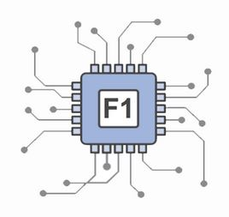
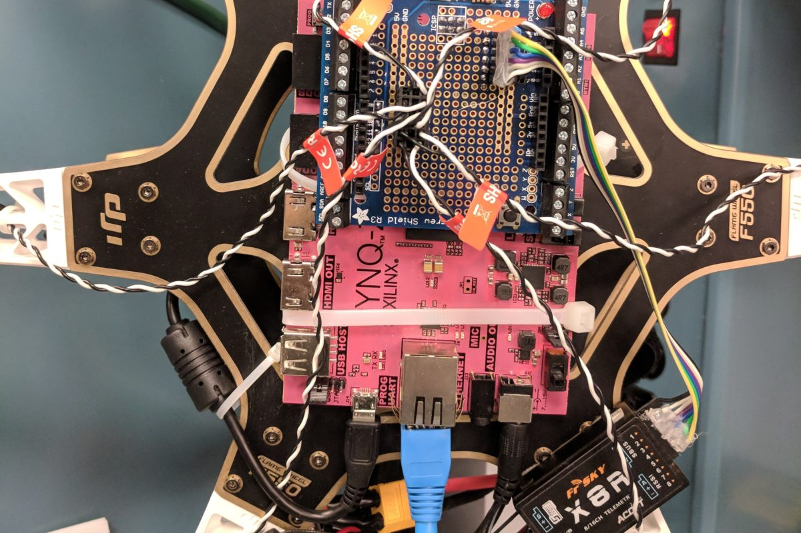



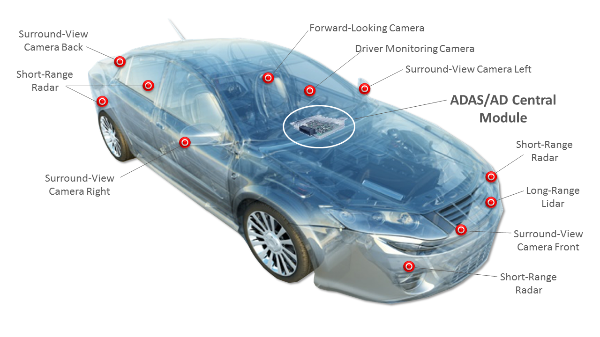


FPGAs in DNN Applications
FPGA in Cloud Computing
FPGA in Edge Computing
[ref] Where Do FPGAs Stand in Auto IC Race? https://www.eetimes.com/document.asp?doc_id=1333419#
[ref] PYNQ on UAV http://brennancain.com/pynqcopter-an-open-source-fpga-overlay-for-uavs/
Notes:
The workflow of deploying neural architecture on FPGA consists FPGA accelerator design, the HDL code generation, synthesis, place and routing, and hardware performance evaluation. Among these steps, in accelerator design and HDL code generation, hardware design knowledge is mandatory (click) . And for synthesis, and place&routing, (click)it can take dozens of hours. Such lengthy development can be an obstacle when Deploying Neural Architecture on FPGA. (click)

Slide 9
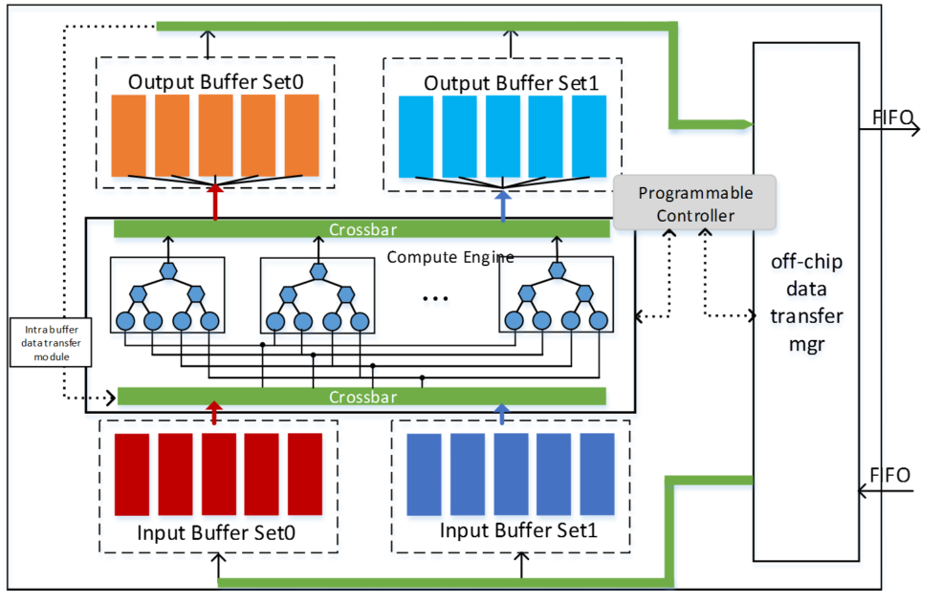
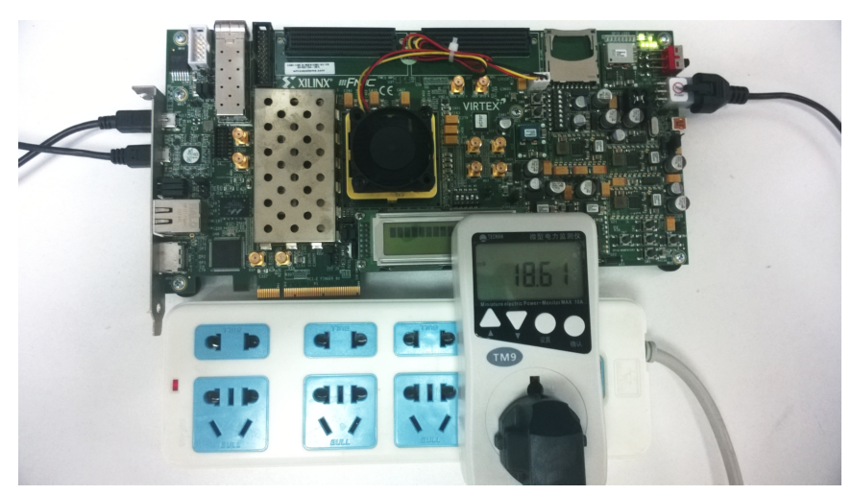
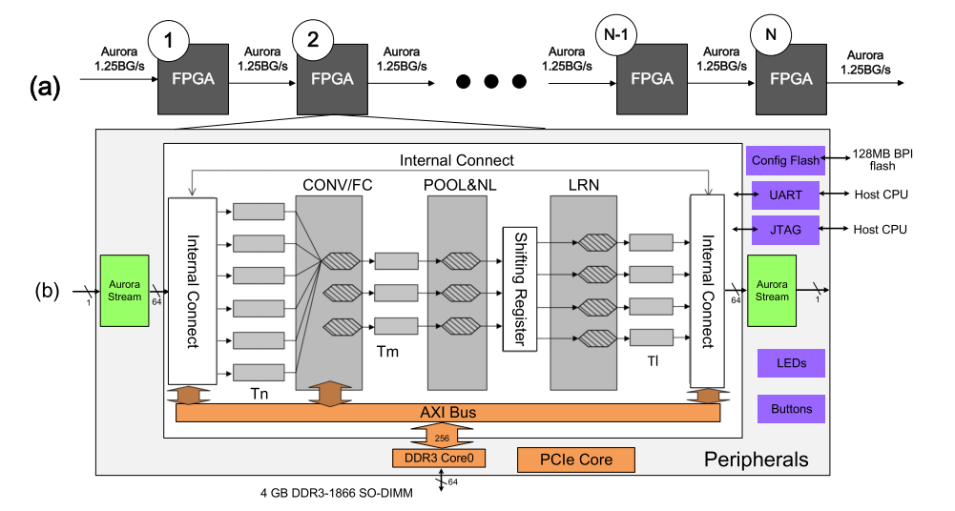
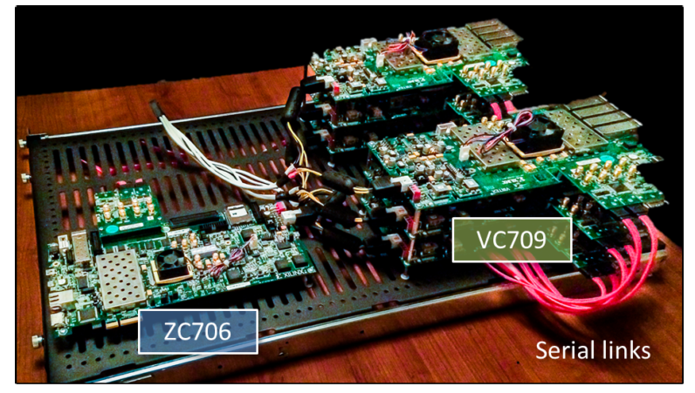
Response to Limited Resource: Pipelining Multi-FPGA
Single-FPGA
Pipelined FPGAs
Limited Resource → Limited Performance
[Ref] C. Zhang et al. Optimizing fpga-based accelerator design for deep convolutional neural networks. In Proc. of FPGA, pages 161–170. ACM, 2015.
Pipeline→ High Throughput
Latency is not improved
[Ref] C. Zhang et al. Energy-efficient cnn implementation on a deeply pipelined fpga cluster. In Proc. of ISLPED, pages 326–331, 2016.
Notes:
Multi-FPGA is a good solution to response to the limited resource.
In the early design stage, the single FPGA is applied to accelerate the DNN applications.
To increase hardware resource, it is naturally to employing multiple FPGAs to increase performance.
As shown in this slides, authors apply pipelining FPGAs to boost performance.

Slide 10
Pipelining Multi-FPGA: Design Flow
Accelerator Design Parameter
Notes:
We exam the design flow and made three observations.
We outline the design flow in this slides, where a convolutional neural network is given. And it will based on the pipelining idea to be partitioned into different pipeline stages, and map each stage to one FPGA.
To achieve the design, it is based on a performance model, which will determine the design parameters for the accelerator in each FPGA.
Then, the input DNN is divided to form the pipelining FPGAs.
In the following, let’s first see the accelerator design

Slide 11
Accelerator Design Parameters
L
1
L
2
L
3
L
4
1
Layer Model
N
M
K
R
B
…
K
C
…
IFM
L₂=
(
B, M, N, R, C, K
)
OFM
FPGA-based Acceleration
Batch Size (B)
# of IFM
Feature Maps (N)
Column of IFM (C)
# of OFM
Features Maps (M)
Row of IFM (R)
Kernel Size (K)
Loop Tiling
Tm
Tn
Tr
Tc
IFM
Weights
OFM
Layer Parameters:
L=(B, M, N, R, C, K)
Tiling Parameters:
(Tm, Tn, Tr, Tc)
On-chip Memory cannot hold all data
Notes:
As shown in this slides, a convolution layer can be modeled using different parameters according to the activations and weigths.
For the accelerator design, activations and weights are initially stored in off-chip memory.
To execute the accelerator, data will be first moved to on-chip memory in FPGA. Then, computations are conducted in the FPGA to produce the output. Finally, the output will store to the off-chip memory.
However, during this process, due to the limited on-chip memory, we cannot move all data to FPGA once. As a result, loop tiling is proposed to only move partial data to the FPGA. And we can tile the activations and weights along different directions.
These tiling parameters are called design parameters.

Slide 12
Design Parameters Will Significantly Affect the Performance
192
128
…
128
…
Observation:
13
…
weights
13
Different design parameters lead to different performance
13
13
Fig. Convolution of Layer 5 in AlexNet
Optimizations on design parameters
Notes:
After we implement a convolution layer to one FPGA with different design parameters, we can obtain such a design space graph, where each point indicates a design. We have the observation here that different design parameters will lead different performance. Hence, it is important to optimize design parameters.

Slide 13
Pipelining Multi-FPGA Design Flow
Performance Model
Accelerator Design Parameter
Notes:
As shown in this slides, the determination of design parameters depend on the performance model. We next show the effects of performance model on optimizing designs.

Slide 14
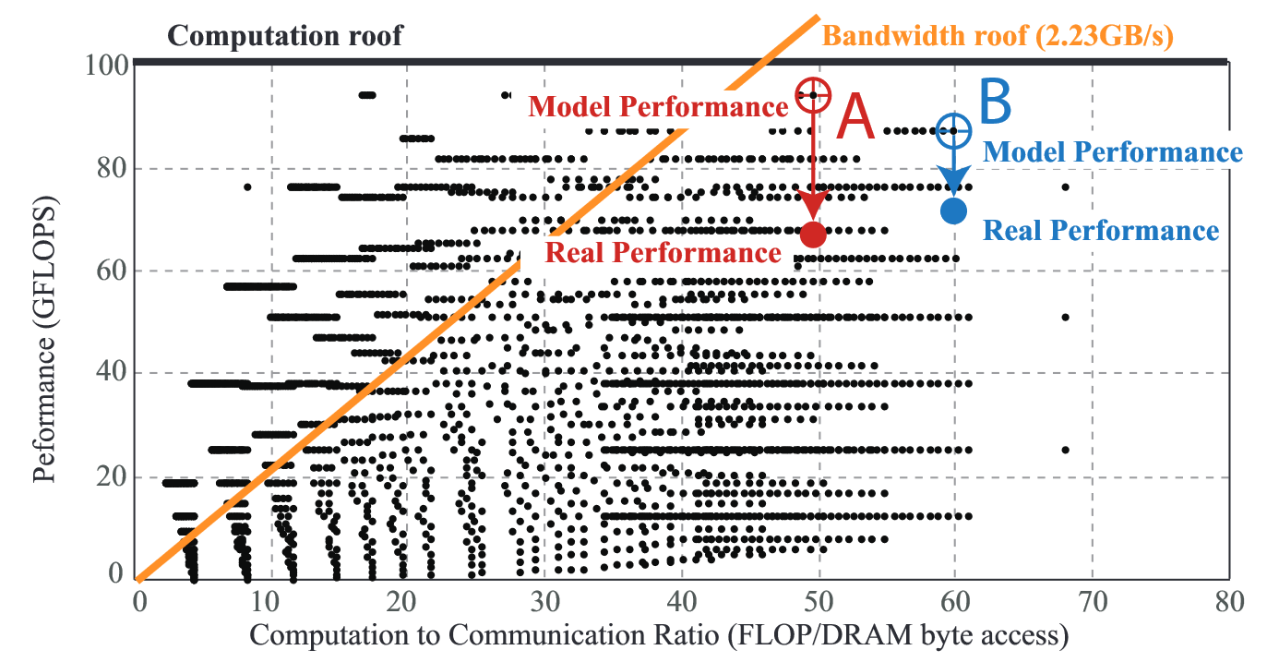
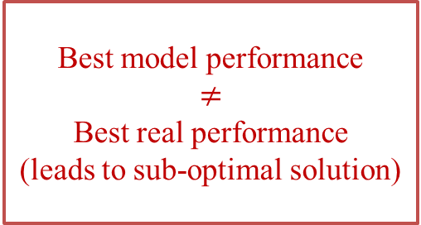
Inaccurate Performance Model Leads to Sub-Optimal Design
Observation:
192
128
…
128
…
Without fine-grained memory access model and inter-FPGA communication model
13
…
weights
13
13
13
Fig. Convolution of Layer 5 in AlexNet
Inaccurate performance model for multi-FPGA
Best model performance
$$≠$$
Best real performance
(leads to sub-optimal solution)
Fig. Real Performance of Layer 5 in Alexnet on ZCU 102
Notes:
As shown in this slides, after we implementing two specific designs, A and B onto the Xilinx board. We observe that the existing performance model without fin-grained communication model is inaccurate. In addition, we observe that the best model performance will not be the best real performance. This indicates that the inaccurate model will lead to the sup-optimal solution.

Slide 15
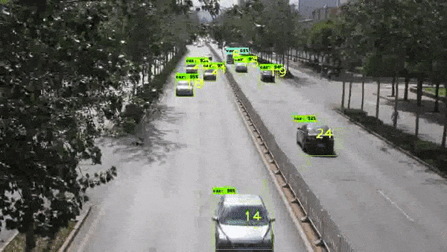
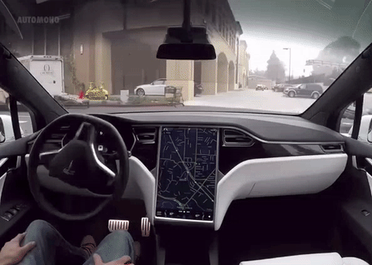
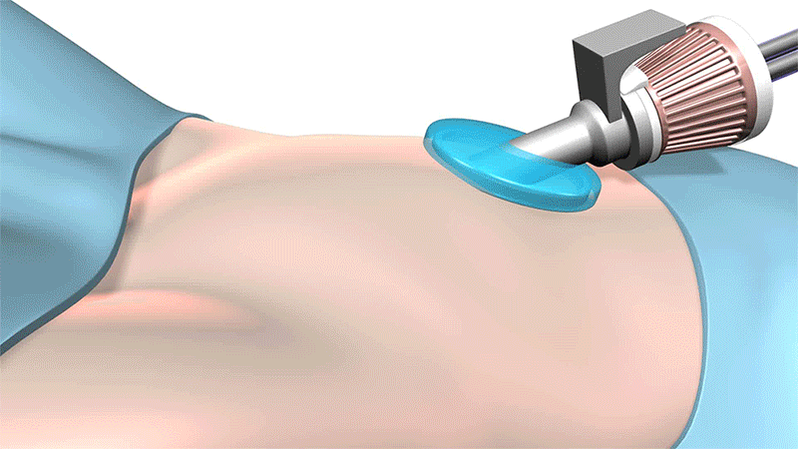
Pipelining Multi-FPGA Design Flow
Traffic Surveillance
Performance Model
Accelerator Design Parameter
Pipelining Design
Will Increase Latency
Self-Driving Vehicle
[ref.1] Google’s Waymo
[ref.2] da Vinci Surgical Robot at St. Francis Health Center - Robotic Gizmos
Robots in Surgery
Notes:
Finally, let’s review the pipelining design. Such a design can improve throughput benefiting from multiple FPGAs, but it cannot improve and even degrade the latency. On the other hand, the current applications mainly have the real-time requirement. In consequence, we need innovations in multi-FPGA design.

Slide 16
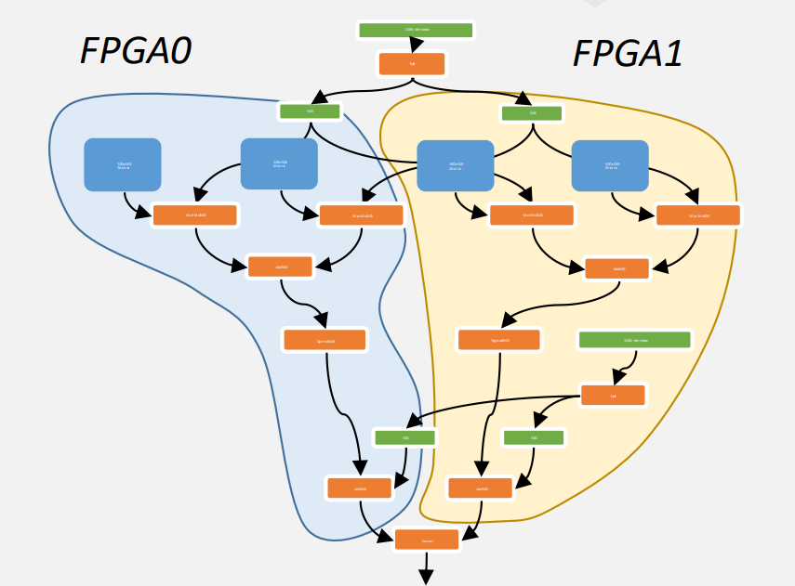
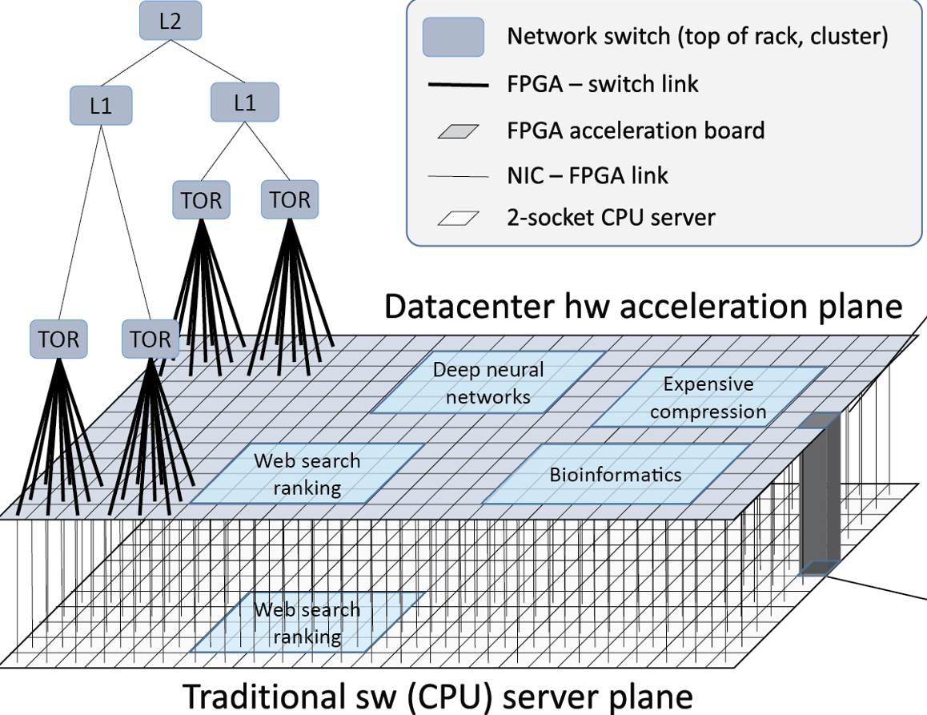
Response to Limited Resource: Pipelining Multi-FPGA
Single-FPGA
Pipelined FPGAs
Weight Locking based Multi-FPGA
Limited Resource → Limited Performance
[Ref] C. Zhang et al. Optimizing fpga-based accelerator design for deep convolutional neural networks. In Proc. of FPGA, pages 161–170. ACM, 2015.
Pipeline→ High Throughput
Latency is not improved
[Ref] C. Zhang et al. Energy-efficient cnn implementation on a deeply pipelined fpga cluster. In Proc. of ISLPED, pages 326–331, 2016.
Lock weights to multiple FPGAs → Specific for RNN
Not applicable for sharing weights (e.g. CNN)
[Ref] Eric Chung, et al. Serving DNNs in Real Time at Datacenter Scale with Project Brainwave, In IEEE Micro, 2018
Notes:
Multi-FPGA is a good solution to response to the limited resource.
In the early design stage, the single FPGA is applied to accelerate the DNN applications.
To increase hardware resource, it is naturally to employing multiple FPGAs to increase performance.
As shown in this slides, authors apply pipelining FPGAs to boost performance.

Slide 17
Super-LIP Framework

Slide 18
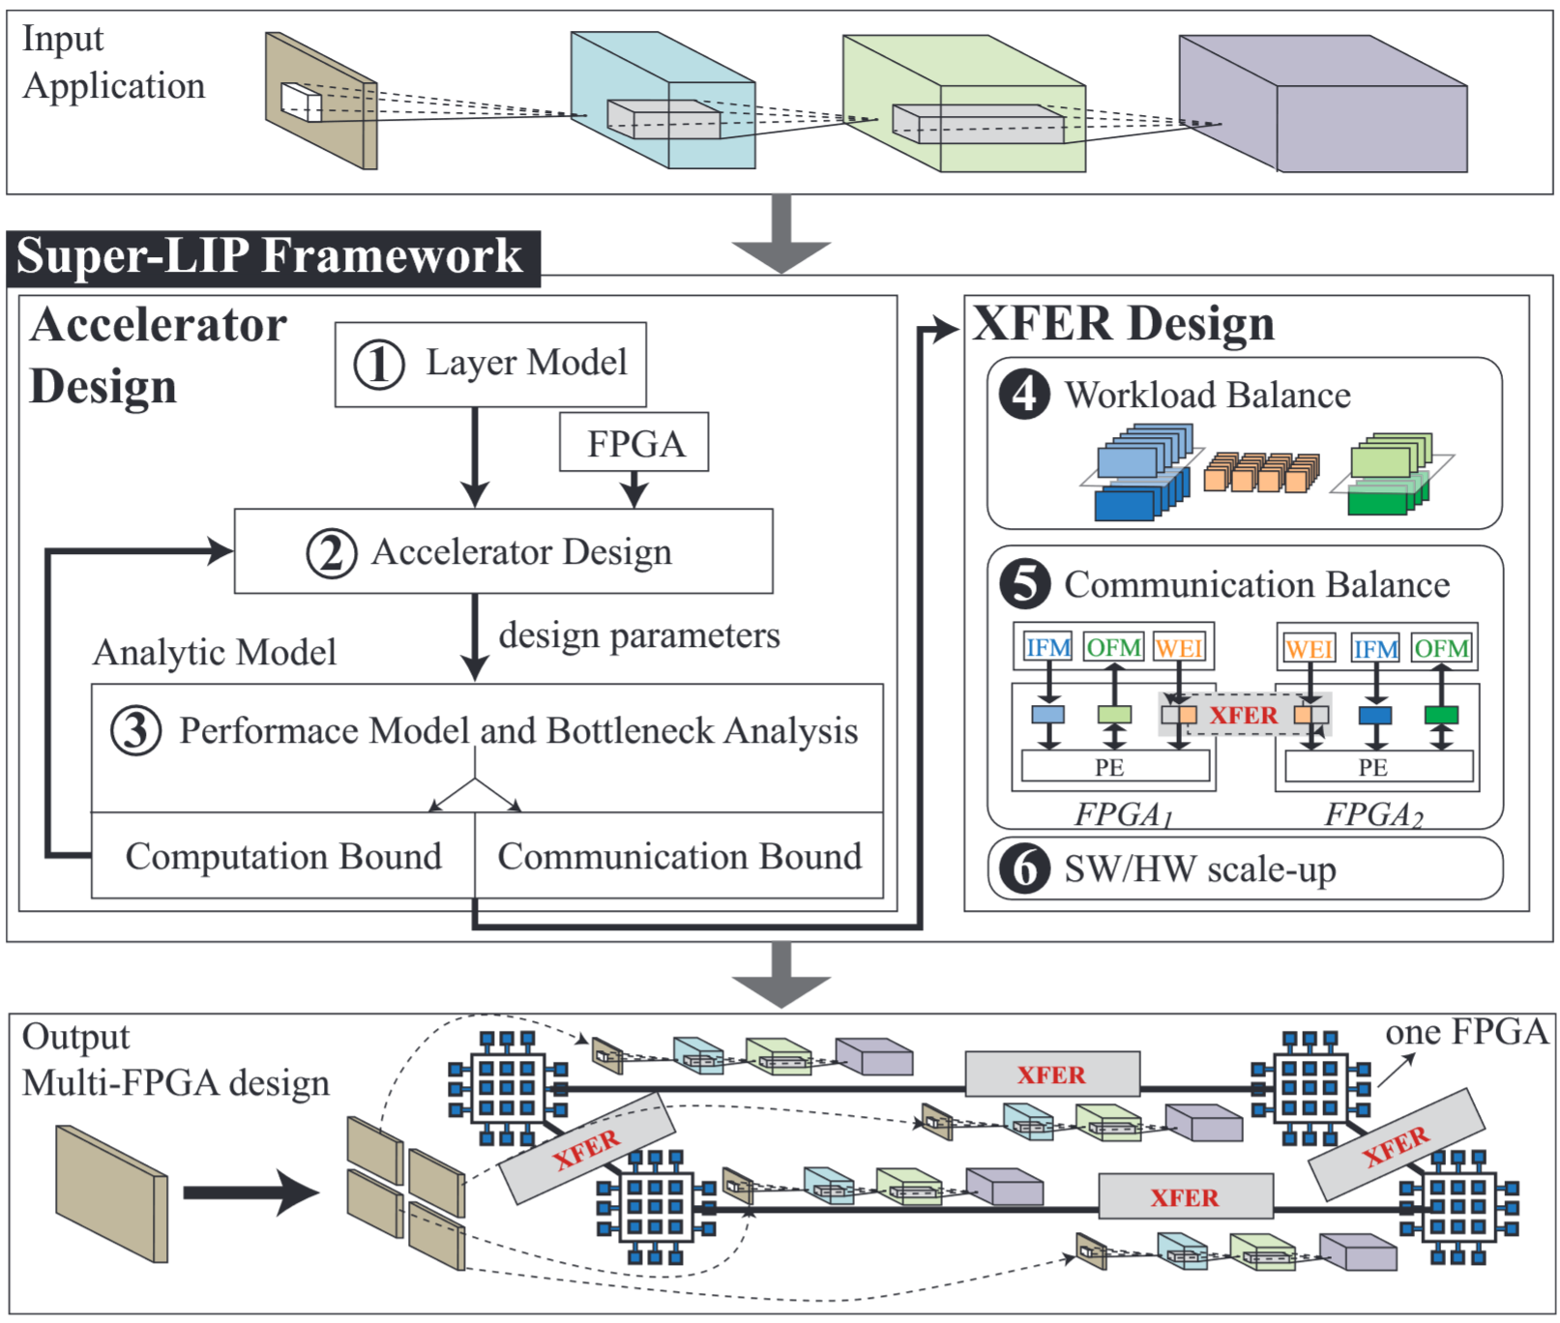
Super-LIP Framework
Optimizing Design Parameters with a more Accurate Model
Accelerator Design
XFER Design
XFER Design
Targeting on Minimizing Latency
Notes:
First, we propose a novel XFER design that targets on minimizing latency.
Second, we proposed a optimization model which can accurately predict the latency of a given design. In addition, the model can support the proposed XFER design with multiple FPGAs.

Slide 19
XFER Design
Super-LIP Framework
Optimizing Design Parameters with a more Accurate Model
Accelerator Design
XFER Design
XFER Design
Targeting on Minimizing Latency

Slide 20
XFER Design

Slide 21
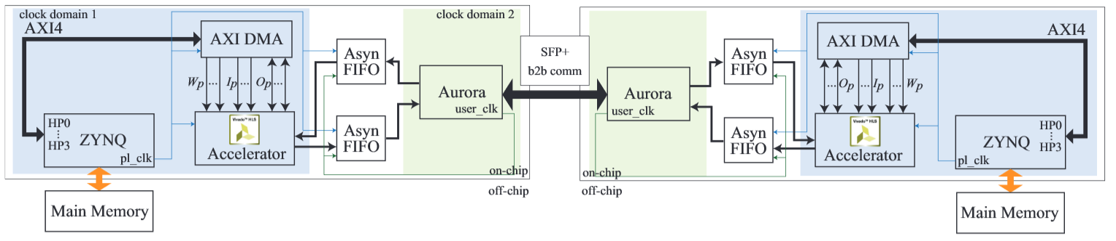
Performance on Single FPGA bounded by Limited Resource
FPGA 1
FPGA 2
K times
(in terms of tiling parameters)
IFM
Weights
OFM
NN | Operation | Cycles | Note
AlexNet Layer 5 | Comm_IFM | 2,612 | Performance Dominated by Comm_Weights Latency is 5,658
 | Comm_Weights | 5,658
 | Comm_OFM | 368
 | Computation | 3,326
Notes:
With FNAS, the neural architecture search evolves to another higher stage.

Slide 22
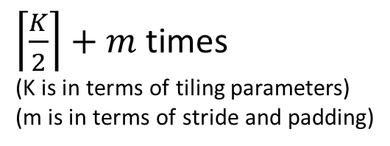
Double Computation Resource cannot Double Performance
FPGA 1
FPGA 2
K times
(in terms of tiling parameters)
IFM
Weights
OFM
$\left\lceil \frac{K}{2}\right\rceil +m$ times
(K is in terms of tiling parameters)
(m is in terms of stride and padding)
NN | Operation | Single | w/o XFER | Note
AlexNet Layer 5 | Comm_IFM | 2,612
 | Comm_Weights | 5,658
 | Comm_OFM | 368
 | Computation | 3,326
w/o XFER
1,412
2,953
234
1,782
Note
1.91X Speedup
Partition
for
Parallel
Notes:
With FNAS, the neural architecture search evolves to another higher stage.

Slide 23
XFER: Achieve Super-Linear Speedup by Transferring Accesses —— from Off-Chip Memory to Inter-FPGA Links
FPGA 1
FPGA 2
XFER
NN | Operation | Single | w/o XFER | w/ XFER | Note
AlexNet Layer 5 | Comm_IFM | 2,612 | 1,412
 | Comm_Weights | 5,658 | 2,953
 | Comm_OFM | 368 | 234
 | Computation | 3,326 | 1,782
w/ XFER
1,412
1,695
234
1,782
Note
Bottleneck Moves to Comp. 3.18X Speedup
Further Partition
Weights
Notes:
With FNAS, the neural architecture search evolves to another higher stage.

Slide 24
XFER Design
Application Optimization —— Partitioning
Weight Sharing: (P_{b}, P_{r}, P_{c})
IFM Sharing: (P_{m})

Slide 25
Performance Model

Slide 26
XFER Design
Super-LIP Framework
Optimizing Design Parameters with a more Accurate Model
Accelerator Design
XFER Design
XFER Design
Targeting on Minimizing Latency

Slide 27
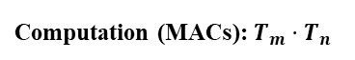
Accelerator Design —— Accurate Model
Accelerator Design —— On-Chip Design
Accelerator Model
Communication Parameters (bit/cycle):
Ip: bandwidth for loading IFM
Wp: bandwidth for loading weights
Op: bandwidth for storing OFM
Computation (MACs): $T_{m}⋅T_{n}$
OFM Stationary Data Flow

Slide 28
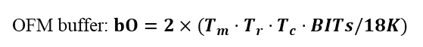
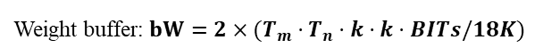
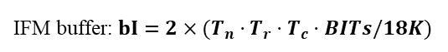
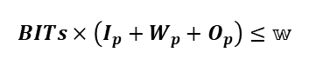
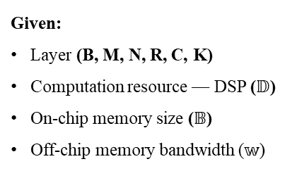
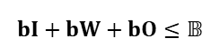
Accelerator Design —— Accurate Model
Accelerator Design —— Optimization under Resource Constraints
Problem Definition
Determine:
Tiling: (Tm, Tn, Tr, Tc)
Bandwidth allocation: (Ip, Wp, Op)
Partition: (Pb, Pr, Pc, Pm)
Given:
Layer (B, M, N, R, C, K)
Computation resource — DSP ($𝔻$)
On-chip memory size ($𝔹$)
Off-chip memory bandwidth ($𝕨$)
Objective:
Minimizing latency under resource constraints
Computation Resource Constraint
Computation(32-bit): $T_{m}⋅T_{n}≤𝔻$; or (16-bit) $5⋅T_{m}⋅T_{n}≤𝔻$;
Memory Resource Constraints
IFM buffer: $bI=2×(T_{n}⋅T_{r}⋅T_{c}⋅BITs/18K)$
bitwidth(32b or 16b)
Weight buffer: $bW=2×(T_{m}⋅T_{n}⋅k⋅k⋅BITs/18K)$
Communication Parameters (bit/cycle):
Ip: bandwidth for loading IFM
Wp: bandwidth for loading weights
Op: bandwidth for storing OFM
OFM buffer: $bO=2×(T_{m}⋅T_{r}⋅T_{c}⋅BITs/18K)$
BRAM blokc size
$$bI+bW+bO≤𝔹$$
Communication Resource Constraint
Computation (MACs): $T_{m}⋅T_{n}$
$$BITs×\left(I_{p}+W_{p}+O_{p}\right)≤𝕨$$
OFM Stationary Data Flow

Slide 29
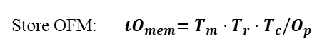
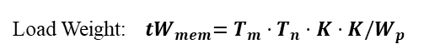
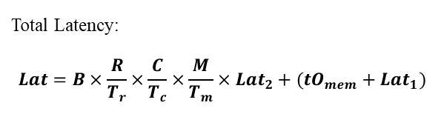
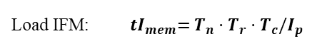
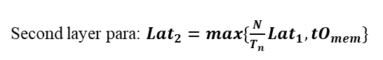
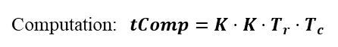
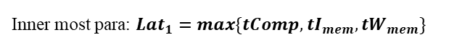
Accelerator Design —— Accurate Model
Accelerator Design —— Optimization under Resource Constraints
Problem Definition
Determine:
Tiling: (Tm, Tn, Tr, Tc)
Bandwidth allocation: (Ip, Wp, Op)
Partition: (Pb, Pr, Pc, Pm)
Given:
Layer (B, M, N, R, C, K)
Computation resource — DSP ($𝔻$)
On-chip memory size ($𝔹$)
Off-chip memory bandwidth ($𝕨$)
Objective:
Minimizing latency under resource constraints
Memory Access and Computation Latency
Load IFM: ${ tI}_{mem}=T_{n}⋅T_{r}⋅T_{c}/I_{p}$
Load Weight:${ tW}_{mem}=T_{m}⋅T_{n}⋅K⋅K/W_{p}$
Store OFM:${ tO}_{mem}=T_{m}⋅T_{r}⋅T_{c}/O_{p}$
Computation:$tComp=K⋅K⋅T_{r}⋅T_{c}$
Latency under Parallelism: OFM stationary
Communication Parameters (bit/cycle):
Ip: bandwidth for loading IFM
Wp: bandwidth for loading weights
Op: bandwidth for storing OFM
Inner most para: $Lat_{1}=max\{tComp,{tI}_{mem},{tW}_{mem}\}$
Lat1
Second layer para: $Lat_{2}=max\{\frac{N}{T_{n}}Lat_{1},{tO}_{mem}\}$
Lat2
Total Latency:
$$Lat=B×\frac{R}{T_{r}}×\frac{C}{T_{c}}×\frac{M}{T_{m}}×Lat_{2}+({tO}_{mem}+Lat_{1})$$
# of loops
Pipeline loading time
Computation (MACs): $T_{m}⋅T_{n}$
Lat
OFM Stationary Data Flow

Slide 30
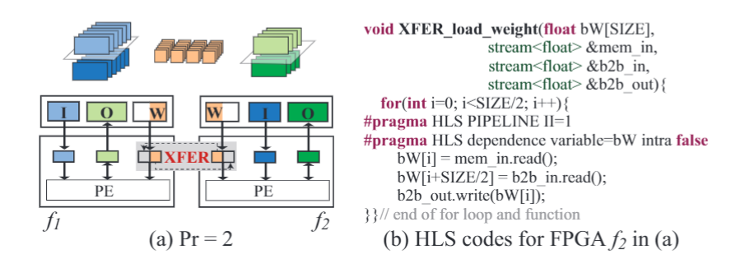
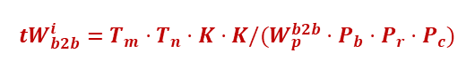
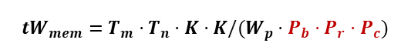
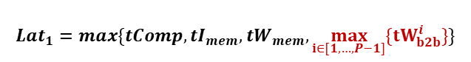
XFER Design
XFER Design —— Weight Sharing
Model Modifications:
Load Weight:
$${tW}_{mem}=T_{m}⋅T_{n}⋅K⋅K/(W_{p}⋅P_{b}⋅P_{r}⋅P_{c})$$
Inter-FPGA latency:
$${tW}_{b2b}^{i}=T_{m}⋅T_{n}⋅K⋅K/(W_{p}^{b2b}⋅P_{b}⋅P_{r}⋅P_{c})$$
Inner most para:
$$Lat_{1}=max\{tComp,{tI}_{mem},{tW}_{mem},\max_{i∈[1,…,P−1]}{\{tW_{b2b}^{i}\}}\}$$

Slide 31
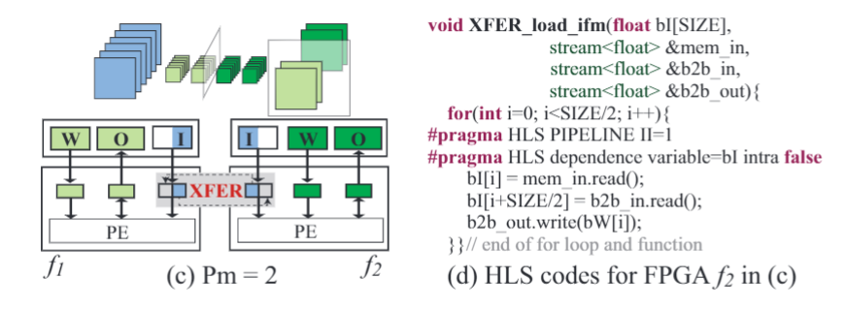
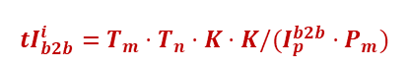
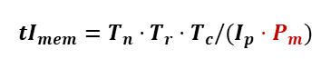
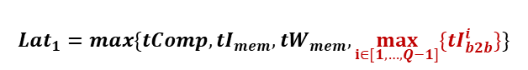
XFER Design
XFER Design —— IFM Sharing
Model Modifications:
Load IFM:
$${tI}_{mem}=T_{n}⋅T_{r}⋅T_{c}/(I_{p}⋅P_{m})$$
$${tI}_{b2b}^{i}=T_{m}⋅T_{n}⋅K⋅K/(I_{p}^{b2b}⋅P_{m})$$
Inter-FPGA latency:
Inner most para:
$$Lat_{1}=max\{tComp,{tI}_{mem},{tW}_{mem},\max_{i∈[1,…,Q−1]}{\{{tI}_{b2b}^{i}\}}\}$$

Slide 32
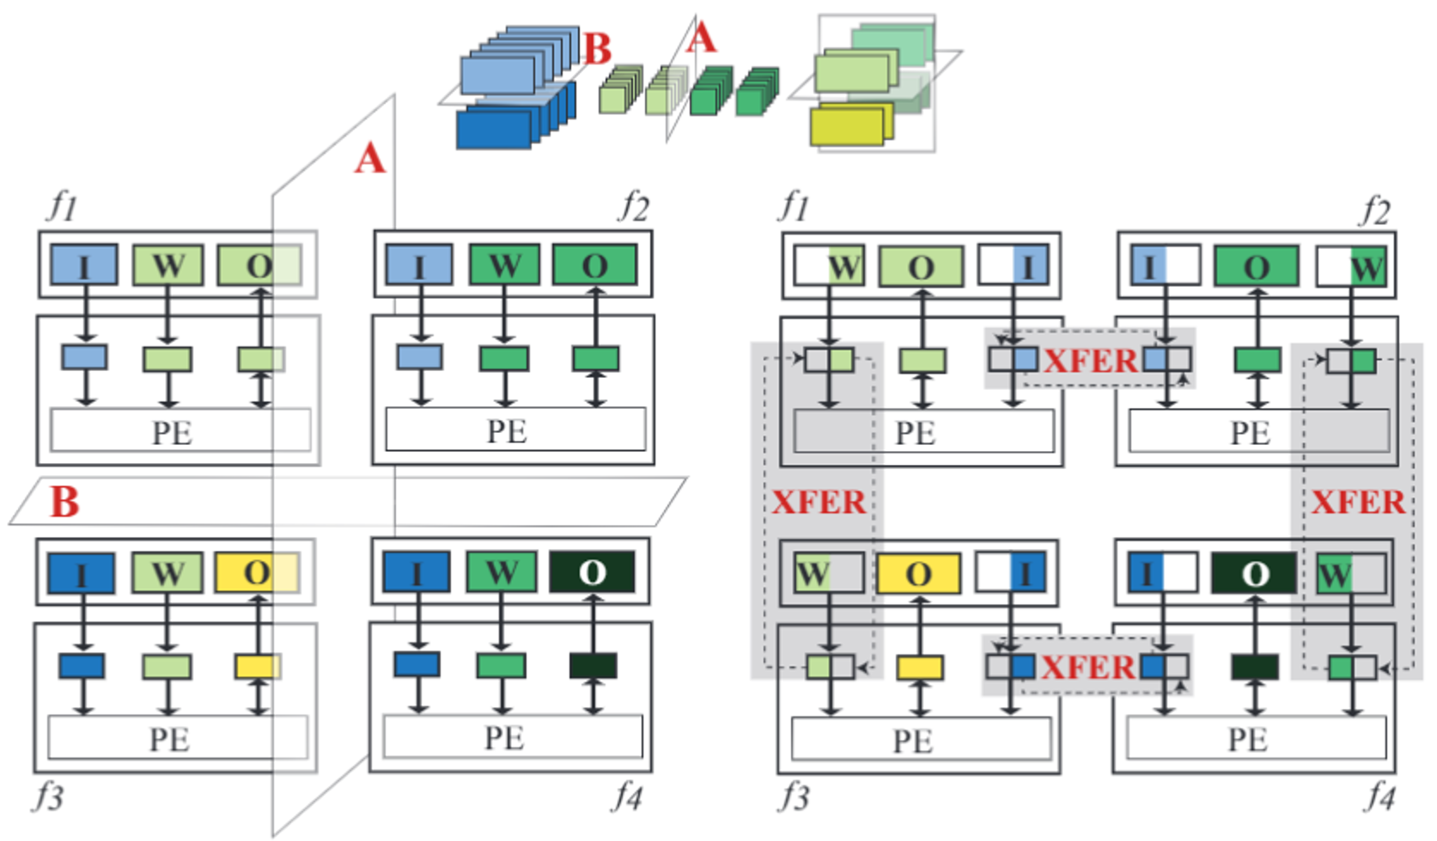
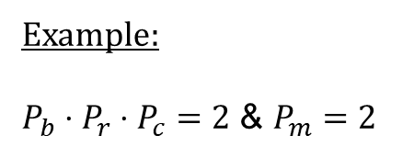
XFER Design
XFER Design —— Scale-Up
Example:
$P_{b}⋅P_{r}⋅P_{c}=2$ & $P_{m}=2$
Topology: 2D-torus
Data Movement: Pipelining

Slide 33
XFER Design
Recap —— Super-LIP Framework
Optimizing Design Parameters with a more Accurate Model
Accelerator Design
XFER Design
XFER Design
Targeting on Minimizing Latency

Slide 34
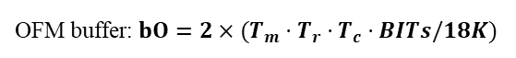
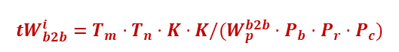
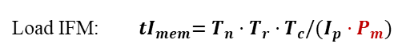
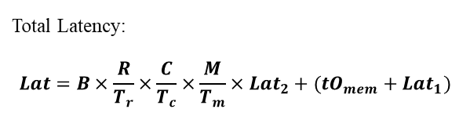










Accelerator Design —— Accurate Model
Model Overview
1. Resource Constraints
2. Memory Access and Computation Latency
Computation(32-bit): $T_{m}⋅T_{n}≤𝔻$; or (16-bit) $5⋅T_{m}⋅T_{n}≤𝔻$;
Load IFM:${ tI}_{mem}=T_{n}⋅T_{r}⋅T_{c}/(I_{p}⋅P_{m})$
IFM buffer: $bI=2×(T_{n}⋅T_{r}⋅T_{c}⋅BITs/18K)$
Load Weight:
Weight buffer: $bW=2×(T_{m}⋅T_{n}⋅k⋅k⋅BITs/18K)$
$${tW}_{mem}=T_{m}⋅T_{n}⋅K⋅K/(W_{p}⋅P_{b}⋅P_{r}⋅P_{c})$$
OFM buffer: $bO=2×(T_{m}⋅T_{r}⋅T_{c}⋅BITs/18K)$
$$bI+bW+bO≤𝔹$$
Store OFM:${ tO}_{mem}=T_{m}⋅T_{r}⋅T_{c}/O_{p}$
$$BITs×\left(I_{p}+W_{p}+O_{p}\right)≤𝕨$$
Computation:$tComp=K⋅K⋅T_{r}⋅T_{c}$
3. Parallelism (Pipelining and Double Buffer)
4. Communication among Multiple FPGAs (XFER)
Inner most para:
Lat1
$$Lat_{1}=max\{tComp,{tI}_{mem},{tW}_{mem},\max_{i∈\left[1,…,P−1\right]}\left\{tW_{b2b}^{i}\right\}$$
$,\max_{i∈[1,…,Q−1]}{\{{tI}_{b2b}^{i}\}}\}$
Transfer IFM:
$${tI}_{b2b}^{i}=T_{m}⋅T_{n}⋅K⋅K/(I_{p}^{b2b}⋅P_{m})$$
Lat2
Second layer para: $Lat_{2}=max\{\frac{N}{T_{n}}Lat_{1},{tO}_{mem}\}$
Transfer Weights:
$${tW}_{b2b}^{i}=T_{m}⋅T_{n}⋅K⋅K/(W_{p}^{b2b}⋅P_{b}⋅P_{r}⋅P_{c})$$
Lat
Total Latency:
$$Lat=B×\frac{R}{T_{r}}×\frac{C}{T_{c}}×\frac{M}{T_{m}}×Lat_{2}+({tO}_{mem}+Lat_{1})$$
Objective: $min=Lat$

Slide 35
Results

Slide 36


Comparison with Existing Designs and GPU Platforms
Testbed:
CNN: AlexNet
FPGA: Xilinx ZUC102 FPGAs connected by SFP+ Links
Comparison results of XFER with comparisons to GPUs and the existing FPGA designs
XFER
Lowest
Latency
among all
competitors
Notes:
Page 22:
Finally, we conduct experiments on Xilinx ZCU102 boards.
Compared with GPU and the existing FPGA implementations, we can see that XFER can achieve the lowest latency.

Slide 37

Comparison with Single-FPGA Design on ZCU102 Boards
Comparison results of XFER with SOTA single FPGA design
Achieve Super-Linear Speedup for both 32-bits and 16-bits implementations
Notes:
Page 23:
Compare with the single-FPGA design, we can see that we can achieve more than 2 times speedup with 2 FPGAs.

Slide 38
Model Accuracy Evaluation
Ours: average deviation is only 2.53%
Existing model: deviation is up to 45.47%
We can accurately estimate performance of multiple FPGAs
Performance Bottleneck Detection and Alleviation using the proposed model

Slide 39


Open Source
https://github.com/PITT-JZ-COOP/XFER_FPGA
Performance Model
XFER Design
HLS
SDK
Vivado_project

Slide 40
Outline
Introduction
XFER: Achieving Super-Linear Speedup across Multi-FPGA
- CODES+ISSS’19 (Best Paper Finalist)
Co-Exploration of Neural Architecture and FPGA Implementation
- DAC’19 (Best Paper Finalist)
Other Research Directions
Conclusion
39
Notes:
Page 1:
My talk will be composed of four parts.
First, I will brefiely introduce the background of these works.
Then, I’ll present two recent works. The first one is transfer, which is a design to achieve super-linear performance of convolutional neural networks across Multiple FPGAs. This work is just accepted by CODES+ISSS.
The second one is FNAS, which is a framework to support co-exploration of Neural Architectures and FPGA implementations.
Finally, I’ll conclude this talk.

Slide 41
Efforts on Both Software and Hardware Sides are Required
Neural Architecture Search
Neural Architecture Implementation on FPGAs
40
40
Notes:
To maximize the energy efficiency, starting from 2015, a lot of works are carried out to implement a fixed architecture on FPGA.
However, with the growing demands on real-time AI, it is more critical to improve the timing performance of FPGA accelerators, which are usually bounded by the limited resource on one FPGA.
To response to this problem, there is trend to involve multiple FPGAs to implement deep neural networks.
But, it still lacks a design to efficiently utilize multiple FPGAs. Our transfer work aims to address this problem.
On the other hand, in the last 2 years, there are sharply increasing number of works targeting on neural architecture search. This has already become a very hot topic.
However, there is still a missing link between the neural architecture search and FPGA-implementation, so how do we search for neural architecture that works best for FPGA is still unknown.
Our FNAS work aims to propose a co-exploration framework to fill this gap.
In the following, I’ll introduce the backgrounds on FPGA-implementation side and Neural Architecture Search side in turn.

Slide 42
Evolution of Exploring Deep Neural Architectures
proxylessNAS
from MIT
FBNet
from UCB & Facebook
MnasNet
from Google
III. Hardware-Aware
Neural Architecture Search
2018.July
2018.Nov
2018.Dec
2019
II. Pure Automatically Explore Neural Architecture Space
Neural Architecture Search (RL-based)
I. Human
Invented
2012
2013
2014
2015
2016
2017
2018
2019
2020
AlexNet
ZFNet
VGGNet
GoogLeNet
Notes:
We can divide the evolution of exploring neural architectures in four stages.
The first stage is human invented stage, in which neural architectures are manually explored by experts, however, it requires large expertise and labor. (click)
Then, in the second stage, neural architecture search algorithms is proposed to automatically identify architectures. It release the expertise but can easily become useless since their structures are too complicated and cannot satisfy the timing performance. (click)
The third stage is the hardware-aware neural architecture search, which involve the hardware-efficiency in the search loop. (click)
Finally, our FNAS work pushes the exploration to the fourth stage, which will co-explore neural architecture and hardware design.
In the following slides, I will introduce each stage in detail and show the motivation of the co-exploration.

Slide 43




Phase I: Human Invented
AlexNet
……
VGGNet
Design arch. for dedicated application
Era of AI Democratization
Problem
Domain knowledge and excessive labor
It is impossible to manually design specific arch. for dedicated application in the era of AI democratization
Notes:
In the first stage, the neural network architectures are designed for the dedicate applications and dataset; for instance, the AlexNet and VGGNet are designed for image classification application on ImageNet dataset. (click)
However, when it comes to the era of AI democratization, there are exponentially growing number of applications. As a result, it is impossible to manually design architectures for each application.

Slide 44



Phase II: Neural Architecture Search (NAS)
Sample architecture NN with probability p
before convergence
after convergence
Controller (RNN)
Train a child network with architecture
NN to get accuracy A
Identified
NN
Compute gradient of p and scale it by A to update the controller
Intelligent Cloud
with Enough Computing Power
Problem
No constraint on hardware resource consumed
NAS may not meet the design specifications in resource constraint environment
Intelligent Edge with Limited Computing Power
REF: Zoph, Barret, and Quoc V. Le. "Neural architecture search with reinforcement learning." ICLR 2017
Notes:
In such background, the neural architecture search algorithms are proposed to automatically identify the architecture.
The NAS is typically implemented as a search loop, which composed of two components: a controller and a trainer.
The controller will predict the hyperparameters to identify an architecture. And the architecture will be then trained from scratch to obtain the accuracy. Then the accuracy will be feedback to update controller with the objective of maximizing the accuracy. (click)
We observe that the network explored by NAS has complicated structures, which is fine for the cloud computing with enough computing power. (click)
But, when it comes to edge computing, which commonly has limited resource and tight hardware specifications (such as latency and throughput), if we directly implement the identified architectures onto the edge devices, it is easily violate the specification and result in the architecture useless.

Slide 45
Phase III. Hardware-Aware NAS
Sample architecture NN with probability p
Different Hardware Designs
Controller (RNN)
Train a child network with architecture
NN to get accuracy A
Predict the efficiency E on a fixed hardware (e.g. mobile phone)
Compute gradient of p and scale it by A and E to update the controller
Problem
It works for particular fixed hardware, but not suitable for programmable hardware
REF: Mingxing Tan, et al. "MnasNet: Platform-Aware Neural Architecture Search for Mobile.” arXiv 2018
Notes:
To solve this problem, hardware-aware NAS is proposed, which adds an extra component in the search loop as shown in this slide.
It will test the hardware efficiency after training the neural network. (click)
In this way, the hardware efficiency can be guaranteed, but it increases the latency of search process. (click)
What’s more, it only works for fixed hardware, but not suitable for the programmable hardware.

Slide 46
A Missing Link between Two Design Spaces
Neural Architecture Search
Neural Architecture Implementation on Hardware
Notes:
Although two design spaces have been well explored, there is a missing link between these two spaces.
What’s more, we observe that these two spaces are tightly coupled, separately optimization will lead to inferior solutions.
Therefore, it is best to jointly explore these two spaces.
FNAS is proposed to remedy this gap.

Slide 47
Evolution of Exploring Deep Neural Architectures
IV. Co-Explore Neural Architecture Space
and Hardware Design Space
DAC19 FNAS
from ND
……
proxylessNAS
from MIT
FBNet
from UCB & Facebook
MnasNet
from Google
III. Hardware-Aware
Neural Architecture Search
2018.July
2018.Nov
2018.Dec
2019
II. Pure Automatically Explore Neural Architecture Space
Neural Architecture Search (RL-based)
I. Human
Invented
2012
2013
2014
2015
2016
2017
2018
2019
2020
AlexNet
ZFNet
VGGNet
GoogLeNet
Notes:
We claim that, the proposed FNAS pushes the neural architecture evolution into the fourth stage, that is, co-exploration stage.

Slide 48
FNAS Framework

Slide 49
HW-Aware NAS vs. FPGA-Implementation Aware NAS（FNAS）
Output: A neural architecture
Output: A pair of neural architecture and hardware design
HW-Aware NAS
FNAS
Notes:
We first show the difference between the co-exploration framework with the existing hardware-aware NAS.
As stated, the hardware-aware NAS integrated a component to test the accuracy for each child network. It finally outputs a neural architecture with high accuracy. (click)
Unlike this framework, our proposed co-exploration framework is composed of two levels of exploration.
The top layer shows the hardware exploration level, and the bottom layer shows the software exploration level.
There are two controllers cooperatively explore neural architecture and hardware implementation.
As shown in this slides, after the controller for maximizing accuracy generate a child network, our framework can also test its hardware efficiency. If it cannot meet specifications, we can terminate the training early to reduce search time. Otherwise, it applies the latency and accuracy together to update the controller.
Then, the parameters of the controller is copied to the other controller. And it optimizes the hardware implementation with the objective of maximizing hardware efficiency.

Slide 50
Solutions & Challenges
Naïve Solution: HW-Aware + Exhaustively Evaluate Lat.
Exhaustively
Evaluate
Latency
FNAS
Tool
Fig1. Possible designs for Layer 5 of AlexNet on ZCU102
Functional Spec.
HDL
Synthesis
Place & Route
HW Evaluation
Fig2. Procedure of performance evaluation
Our Solution: FNAS tools to response to challenges
Challenges:
C2
C1: Huge design space!
C1
Infeasible
C2: Multi-FPGA design!
C2
C3
C3: Time-consuming evaluation!
Notes:
The naïve solution is to apply hardware-aware approach and exhaustively evaluate performance.
However, it faces a lot of challenges which leads such approach infeasible.
First, it has huge design space. As shown in the figure, each point in the graph represent one possible design, and the design space is huge.
Second, when we consider multiple FPGAs, the design space increases exponentially.
Finally, if we do not have automatic approach to evaluate performance, it is time-consuming.
To address these challenges, we propose the FNAS toolset, which contains four components.

Slide 51


FNAS: Design Optimization (on-chip design)
Given：
1. FPGAs with attributes including DSPs, BRAM, etc.
……
2. A neural architecture with determined hyperparameters
On-chip accelerator design:
Determine：
1. On-chip buffer allocation; 2. Accelerator size for computing
(note: both are determined by tiling parameters, Tm, Tn, Tr, Tc)
Tn/Tm
One layer:
Tn/Tm
Multiple layers:
REF: Chen Zhang et al. 2015. Optimizing fpga-based accelerator design for deep convolutional neural networks. In Proc. of FPGA.
Notes:
The first component is the FNAS-Design. It determine the on-chip buffer size, and accelerator size.
These parameters are affected by tiling parameters. And we have an automatic algorithm to help to determine best parameters given an architecture.

Slide 52


FNAS: Graph Generator
Given：
1. FPGAs with attributes including DSPs, BRAM, etc.
……
2. A neural architecture with determined hyperparameters
High-level graph abstraction
Notes:
The second component is the graph generator. It bases the tiling results to abstract a graph model for the neural network.

Slide 53


FNAS: Schedule (off-chip design)
Given：
1. FPGAs with attributes including DSPs, BRAM, etc.
……
2. A neural architecture with determined hyperparameters
Schedule of tasks in graph on multiple FPGAs
Notes:
Based on the graph model, we build a scheduler to determine the execution order of each operation.

Slide 54

FNAS: Analyzer
Given：
1. FPGAs with attributes including DSPs, BRAM, etc.
……
2. A neural architecture with determined hyperparameters
Latency = pipeline start time + processing time
Output：
1. A tailored FPGA Design
2. The system latency
Notes:
Finally, we based on our FPGA performance model studied in the previous work to efficiently analyze the performance without simulation.

Slide 55
Experimental Results
Notes:
Page 1:
My talk will be composed of four parts.
First, I will brefiely introduce the background of these works.
Then, I’ll present two recent works. The first one is transfer, which is a design to achieve super-linear performance of convolutional neural networks across Multiple FPGAs. This work is just accepted by CODES+ISSS.
The second one is FNAS, which is a framework to support co-exploration of Neural Architectures and FPGA implementations.
Finally, I’ll conclude this talk.

Slide 56




Experimental Setting
FPGAs
Xilinx 7A50T
Xilinx 7Z020
Datasets
MNIST
CIFAR-10
ImageNet
Layer Num.
up to 5
up to 10
up to 15
NAS Search Space
Filter Size
[5, 7, 14]
[1, 3, 5, 7]
[1, 3, 5, 7]
Filter Num.
[9, 18, 36]
[24, 36, 48, 64]
[16, 32, 64, 128]
HW Search Space
Channel Tiling Para. (Tm,Tn); Row Tiling Para. (Tr); Col Tiling Para. (Tc); Schedule
Timing Spec. (ms)
[2, 5, 10, 20]
[1.5, 2, 2.5, 10]
[2.5, 5, 7.5, 10]
Notes:
In the experiments, we use different FPGAs to composed the hardware design space.
For the architecture search space, we specify number of layers, filter sizes, and filter numbers for different dataset, including MNIST, CIFAR-10 and ImageNet.
We also test using different timing specifications.

Slide 57



Experimental Results
Different Hardware (MNIST)
Different Datasets (7Z020)
Compare to HW-Aware NAS
(CIFAR-10 + 7Z020)
Baseline: NAS
up to 11.13X reduction in search time
loose
below 1% loss in accuracy
up to 7.81X reduction in inference latency
FNAS can significantly push forward the Pareto frontiers between accuracy and efficiency tradeoff
up to 10X reduction in inference latency
below 0.9% loss in accuracy
Notes:
We conduct experiments on different hardware and datasets. We also compare FNAS with original NAS and hardware-aware NAS.
As shown in the first group of experiments, where the x-axis represent different FPGAs, and y-axis represent search time, latency, and accuracy. We can see that FNAS can achieve 11 times reduction on search time, and 7 times reductions on latency, with only 0.9 percent accuracy loss.
For different datasets, we can obtain similar results.
Finally, we show that FNAS can significantly push forward the Pareto frontiers between accuracy and efficiency tradeoff.

Slide 58
Experimental Results: Importance of Co-Exploration
Model Size
149k ~ 150k
Hardware Efficiency
7.02% ~ 98.53%
In the design space:
Models with similar model sizes may have distinct hardware efficiency
=> Cannot restrict model size to guarantee hardware efficiency

Slide 59
Outline
Introduction
XFER: Achieving Super-Linear Speedup across Multi-FPGA
- CODES+ISSS’19 (Best Paper Finalist)
Co-Exploration of Neural Architecture and FPGA Implementation
- DAC’19 (Best Paper Finalist)
Other Research Directions
Conclusion
58
Notes:
Page 1:
My talk will be composed of four parts.
First, I will brefiely introduce the background of these works.
Then, I’ll present two recent works. The first one is transfer, which is a design to achieve super-linear performance of convolutional neural networks across Multiple FPGAs. This work is just accepted by CODES+ISSS.
The second one is FNAS, which is a framework to support co-exploration of Neural Architectures and FPGA implementations.
Finally, I’ll conclude this talk.

Slide 60
Our Work on Co-Exploring Neural Architecture and Hardware
FPGA Implementation-Aware NAS
(FNAS)
DAC’19 Best Paper Nomination
59
59

Slide 61
Our Work on Co-Exploring Neural Architecture and Hardware
FPGA Implementation-Aware NAS
(FNAS)
Scalability (multiple-FPGAs, NoCs, etc.)
Limited Resource (quantization, etc.)
Novel Computing Architectures (in-memory Computing, NVM, etc.)
DAC’19 Best Paper Nomination
……
60
60

Slide 62


Design Neural Networks on Scalable Architecture
FPGA Implementation-Aware NAS
(FNAS)
Scalability in Cloud Computing (multiple-FPGAs, NoCs, etc.)
Super-Linear Speedup across Multiple FPGAs (XFER)
Co-Explore Network-on-Chip Design and Neural Architectures (NANDS)
CODES+ISSS’19
Best Paper Nomination
ASP-DAC’20
Best Paper Nomination
DAC’19 Best Paper Nomination
61
61

Slide 63
Design Neural Networks for Resource-Limited Device
FPGA Implementation-Aware NAS
(FNAS)
Scalability in Cloud Computing (multiple-FPGAs, NoCs, etc.)
Limited Resource in Edge Computing (quantization, etc.)
Novel Computing Architectures (in-memory Computing, NVM, etc.)
DAC’19 Best Paper Nomination
……
62
62

Slide 64

Design Neural Networks for Resource-Limited Device
FPGA Implementation-Aware NAS
(FNAS)
Limited Resource in Edge Computing (quantization, etc.)
Co-Explore Quantization and Neural Architectures (QuanNAS)
ICCAD’19
DAC’19 Best Paper Nomination
63
63

Slide 65
Design Neural Networks for Novel Computing Architectures
FPGA Implementation-Aware NAS
(FNAS)
Scalability in Cloud Computing (multiple-FPGAs, NoCs, etc.)
Limited Resource in Edge Computing (quantization, etc.)
Novel Computing Architectures (in-memory Computing, NVM, etc.)
DAC’19 Best Paper Nomination
……
64
64

Slide 66

Design Neural Networks for Novel Computing Architectures
FPGA Implementation-Aware NAS
(FNAS)
Novel Computing Architectures (in-memory Computing, NVM, etc.)
Integrating Memristors and CMOS for Better AI
Co-Explore Neural Architectures and Devices
Ongoing Project
DAC’19 Best Paper Nomination
Nature Electronics’19
65
65

Slide 67
Outline
Introduction
XFER: Achieving Super-Linear Speedup across Multi-FPGA
- CODES+ISSS’19 (Best Paper Finalist)
Co-Exploration of Neural Architecture and FPGA Implementation
- DAC’19 (Best Paper Finalist)
Other Research Directions
Conclusion
66
Notes:
Page 1:
My talk will be composed of four parts.
First, I will brefiely introduce the background of these works.
Then, I’ll present two recent works. The first one is transfer, which is a design to achieve super-linear performance of convolutional neural networks across Multiple FPGAs. This work is just accepted by CODES+ISSS.
The second one is FNAS, which is a framework to support co-exploration of Neural Architectures and FPGA implementations.
Finally, I’ll conclude this talk.

Slide 68



Conclusion and Future Work
XFER
NANDS
QuanNAS
AI Democratization
FNAS
FNAS
Neural Network
Architecture
Search
?
?
Large Scale System
for Real-Time AI
New
Architectures
(ASIC, NVM, …)

Slide 69
Reference
[1] Weiwen Jiang, Xinyi Zhang, Edwin H.-M. Sha, Qingfeng Zhuge, Lei Yang, Yiyu Shi and Jingtong Hu, "Accuracy vs. Efficiency: Achieving Both through FPGA-Implementation Aware Neural Architecture Search," in Proc. of DAC 2019. (Best Paper Finalist)
[2] Weiwen Jiang, Edwin Sha, Xinyi Zhang, Lei Yang, Qingfeng Zhuge, Yiyu Shi and Jingtong Hu, "Achieving Super-Linear Speedup across Multi-FPGA for Real-Time DNN Inference," CODES+ISSS 2019 and ACM TECS (Best Paper Finalist)
[3] Lei Yang, Weiwen Jiang, Weichen Liu, Edwin Sha, Yiyu Shi and Jingtong Hu, "Co-Exploring Neural Architecture and Network-on-Chip Design for Real-Time Artificial Intelligence," ASP-DAC 2020 (Best Paper Finalist)
[5] Qing Lu, Weiwen Jiang, Xiaowei Xu, Yiyu Shi and Jingtong Hu, "On Neural Architecture Search for Resource-Constrained Hardware Platforms," in Proc. of ICCAD 2019 (Invited Paper)
[6] Weiwen Jiang, Bike Xie, Chun-Chen Liu and Yiyu Shi, "Integrating Memristors and CMOS for Better AI," Nature Electronics, September 2019
68

Slide 70
Thank You!
Weiwen Jiang
wjiang2@nd.edu
https://wjiang.nd.edu

Slide 71
XFER: Achieve Super-Linear Speedup by Transferring Accesses —— from Off-Chip Memory to Inter-FPGA Links
FPGA 1
FPGA 2
XFER
NN | Operation | Single | w/o XFER | w/ XFER | Note
AlexNet Layer 5 | Comm_IFM | 2,612
 | Comm_Weights | 5,658
 | Comm_OFM | 368
 | Computation | 3,326
w/o XFER
1,412
2,953
234
1,782
w/ XFER
1,412
1,695
234
1,782
Note
Bottleneck Moves to Comp. 3.18X Speedup
Notes:
With FNAS, the neural architecture search evolves to another higher stage.

Slide 72

XFER: Architecture and Motivation
FPGA 1
FPGA 2
Feature
Results & Motivations
Different clock domains for computation (low) and communication (high)
Communication not go through Off-Chip Memory, but directly switch between on-chip buffers
Notes:
With FNAS, the neural architecture search evolves to another higher stage.

Slide 73
Performance on Single FPGA bounded by Limited Resource
FPGA 1
FPGA 2
K times
(in terms of tiling parameters)
IFM
Weights
OFM
NN | Operation | Cycles | Note
AlexNet Layer 5 | Comm_IFM | 2,612 | Performance Dominated by Comm_Weights Latency is 5,658
 | Comm_Weights | 5,658
 | Comm_OFM | 368
 | Computation | 3,326
Notes:
With FNAS, the neural architecture search evolves to another higher stage.

Slide 74

Double Computation Resource cannot Double Performance
$$Observation:$$
Loading IFM, OFM, Computation are conducted independently on two FPGAs
Performance is still dominated by loading weights, and weights are duplicated on two FPGAs
FPGA 1
FPGA 2
K times
(in terms of tiling parameters)
IFM
Weights
OFM
$\left\lceil \frac{K}{2}\right\rceil +m$ times
(K is in terms of tiling parameters)
(m is in terms of stride and padding)
NN | Operation | Single | w/o XFER | Note
AlexNet Layer 5 | Comm_IFM | 2,612
 | Comm_Weights | 5,658
 | Comm_OFM | 368
 | Computation | 3,326
w/o XFER
1,412
2,953
234
1,782
Note
1.91X Speedup
Partition
for
Parallel
Notes:
With FNAS, the neural architecture search evolves to another higher stage.

Slide 75
XFER: Achieve Super-Linear Speedup by Transferring Accesses —— from Off-Chip Memory to Inter-FPGA Links
FPGA 1
FPGA 2
XFER
NN | Operation | Single | w/o XFER | w/ XFER | Note
AlexNet Layer 5 | Comm_IFM | 2,612 | 1,412
 | Comm_Weights | 5,658 | 2,953
 | Comm_OFM | 368 | 234
 | Computation | 3,326 | 1,782
w/ XFER
1,412
1,695
234
1,782
Note
Bottleneck Moves to Comp. 3.18X Speedup
Further Partition
Weights
Notes:
With FNAS, the neural architecture search evolves to another higher stage.

Slide 76
Experimental Results
Testbed:
Xilinx ZUC102 FPGAs connected by SFP+ Links
Comparison results of XFER with comparisons to GPUs and the existing FPGA designs
XFER
Lowest
Latency
among all
competitors
Notes:
With FNAS, the neural architecture search evolves to another higher stage.

Slide 77
Experimental Results
Comparison results of XFER with SOTA single FPGA design
Achieve Super-Linear Speedup for both 32-bits and 16-bits implementations
Notes:
With FNAS, the neural architecture search evolves to another higher stage.

Slide 78
Real-Time Requirement
Robots in Surgery
Self-Driving Vehicle
Increasing Demands on Real-Time Machine Learning Applications
Traffic Surveillance
[ref.1] Google’s Waymo
[ref.2] da Vinci Surgical Robot at St. Francis Health Center - Robotic Gizmos

Slide 79
Experimental Results: Superior to Existing Approaches
Optimizing Hardware Efficiency
Comparison the proposed Co-Exploration with Hardware-Aware NAS and Heuristic Sequential Optimization
n
Optimizing Network Accuracy

Slide 80


QuanNAS: Co-Explore Quantization and Neural Architectures
Search Space
Results
D
D
A,B are first explored by NAS, then to be quantized. In this way, the accuracy loss by quantization is huge.
Besides filter size and shape, we co-explore bit width of weights and activation data, for FPGAs and ASICs.
D,E,F are explored by our Co-Exploration framework, which output
D,E,F are explored by our Co-Exploration framework, which output better accuracy for quantized network with smaller parameter size

Slide 81




NANDS: Co-Explore NoC Design and Neural Architectures
Co-Exploration Framework
D
Why NoC? Complicated Structure from NAS
D
Results
Fixed design (X-Y routing) leads lower performance
31.37% Improvement

Slide 82
Implementing Fixed NNs on FPGAs
[1] Chen Zhang, et al. Optimizing fpga-based accelerator design for deep convolutional neural networks. In FPGA, 2015.
[2] Chen Zhang, et al. Energy-efficient cnn implementation on a deeply pipelined fpga cluster. In ISLPED, 2016.
[3] Chen Zhang, et al. Caffeine: Towards uniformed representation and acceleration for deep convolutional neural networks. ICCAD, 2016.
[4] Yongming Shen, et al. Maximizing cnn accelerator efficiency through resource partitioning. In ISCA, 2017.
[5] Eric Chung, et al. Serving dnns in real time at datacenter scale with project brainwave. IEEE Micro, 2018.
[6] Jeremy Fowers, et al. A configurable cloud-scale dnn processor for real-time ai. In ISCA, 2018.
[7] Weiwen Jiang, et al. Heterogeneous fpga-based cost-optimal design for timing-constrained cnns. CASES – TCAD, 2018.
[8] Xiaofan Zhang, et al. Dnnbuilder: an automated tool for building high-performance dnn hardware accelerators for fpgas. In ICCAD, 2018.
[9] Weiwen Jiang, et al. Xfer: A novel design to achieve super-linear performance on multiple fpgas for real-time ai. In FPGA 2019.
Notes:
However, these works are most for fixed neural arch for FPGA, not about searching for the best neural networks

